Slide 1
The KNIME Demo Library: Machines
Alexander Fillbrunn
July 2021

Slide 2
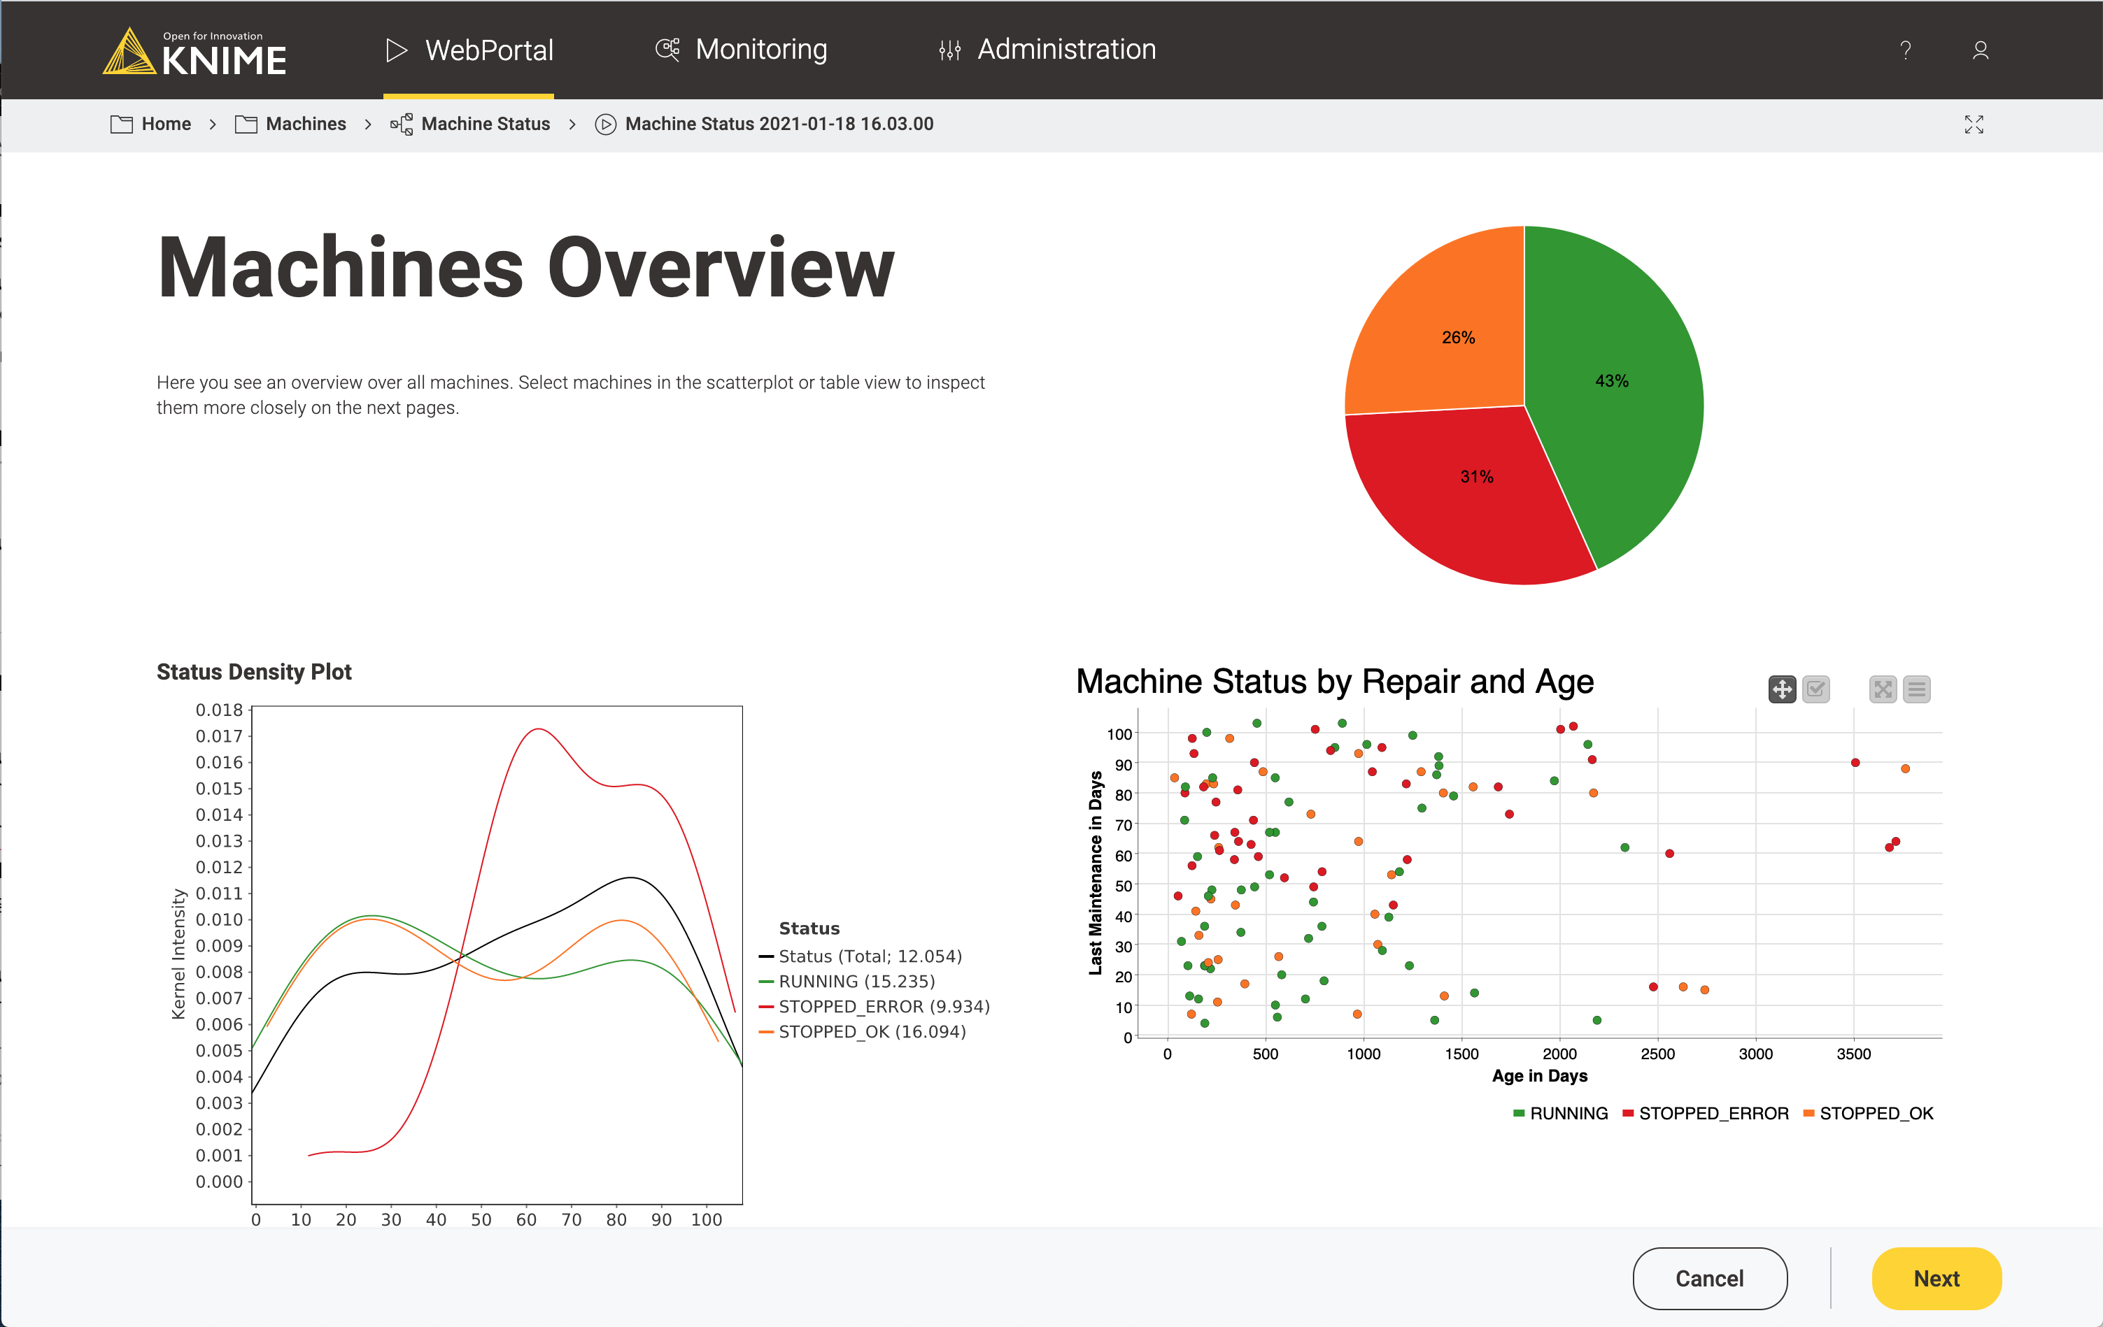
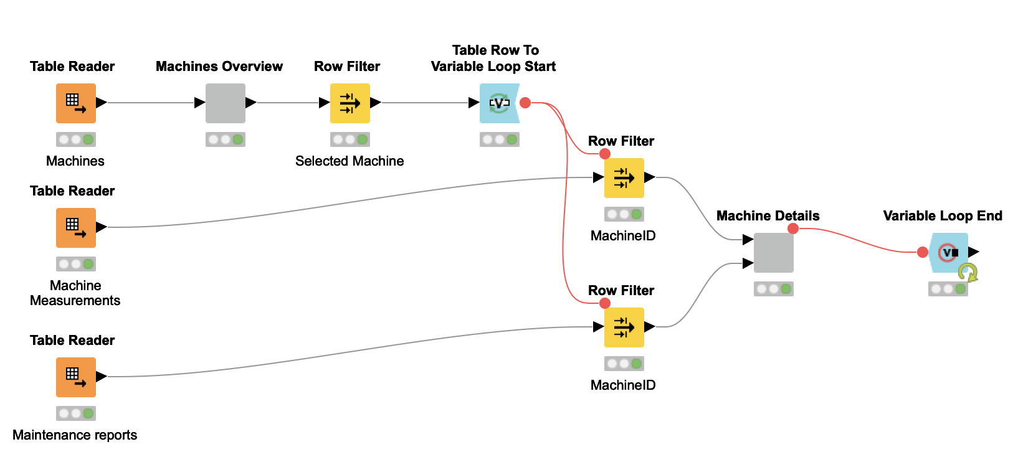
Summary
This set of workflows is meant to show how a workflow can turn into an application and how different user groups in manufacturing can consumer workflow via the WebPortal.

Slide 3
Overview
Focus
WebPortal for different user groups
Database access
Loops in WebPortal
Selection & Filtering
Data
Artificially generated data with
Machine status
Maintenance records
Manufacturing data
Size
5 workflows + data generator
Time
~40 minutes
Any workflow can be skipped

Slide 4





User Groups
KNIME Expert
Builds workflows for
data access and
visualization.
Manufacturing
Expert
Supervises the
manufacturing
Process.
Maintenance
Supervisor
Assigns shifts
and checks
machine status.
Maintenance
Crew
Maintains machines
and creates reports.

Slide 5
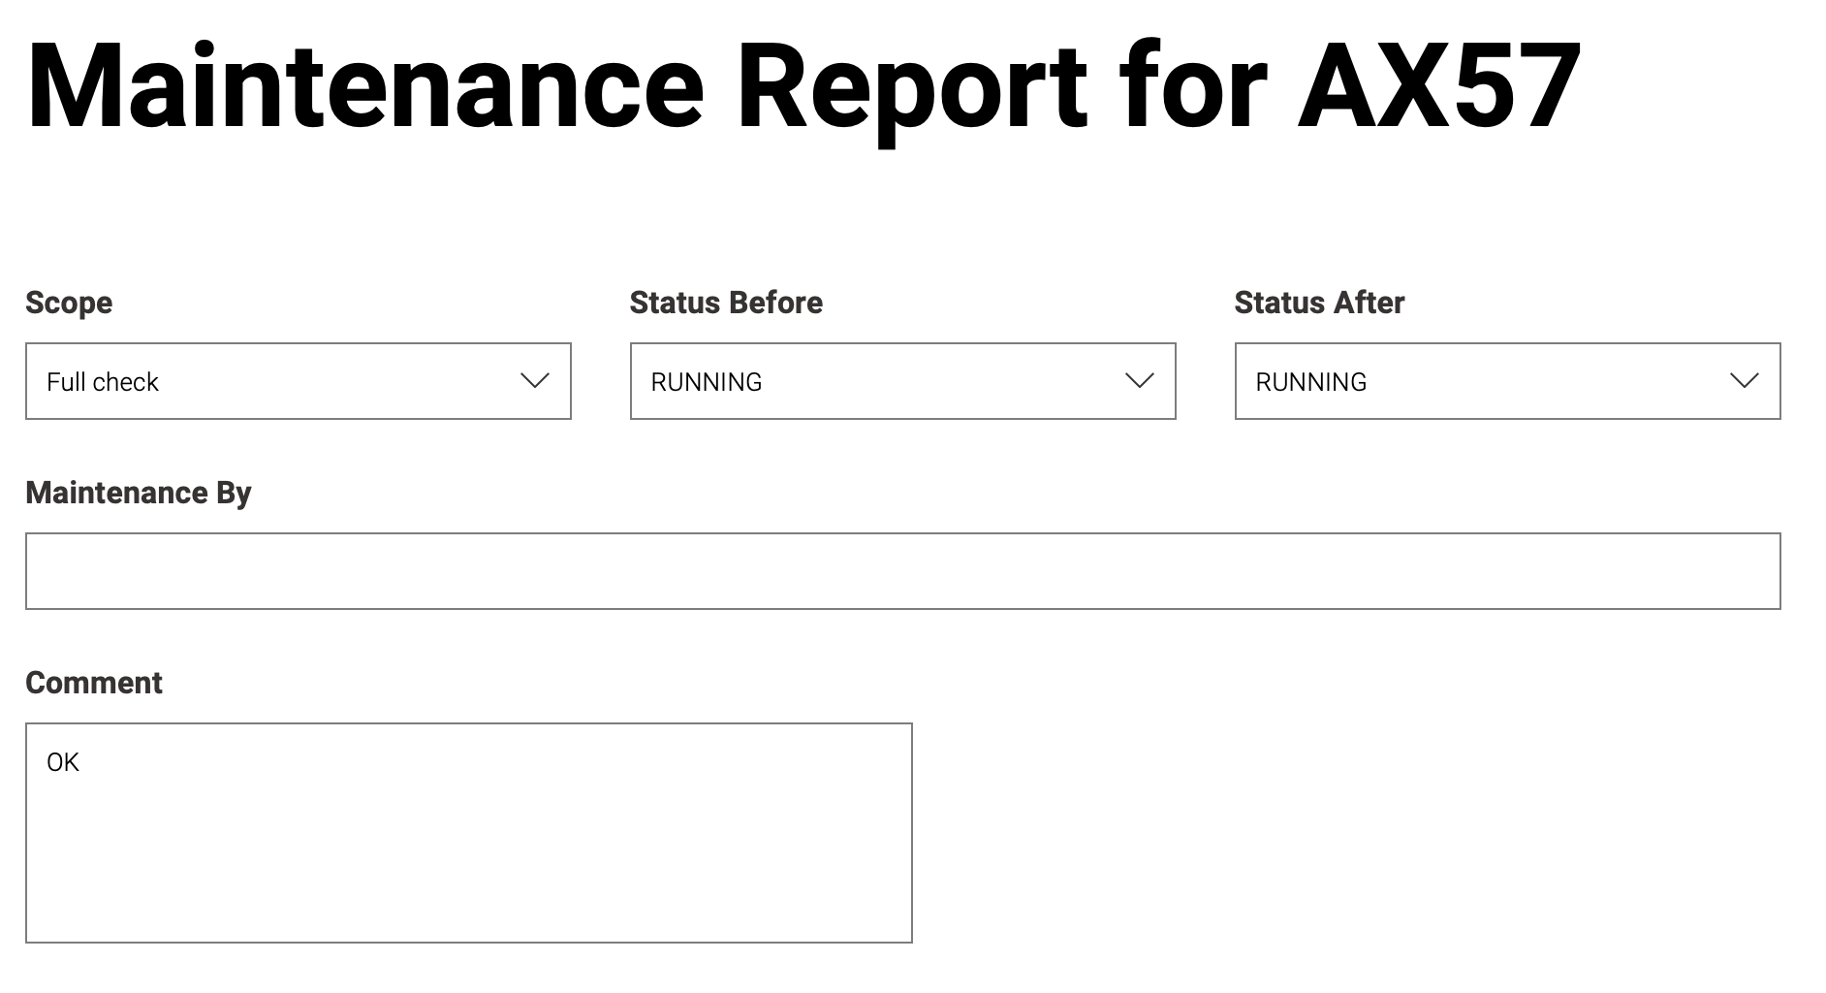
Workflows
Data Browser
Allows viewing and aggregating data
Machine Status
Overview over machines
Manufacturing
Overview over machine output
Repair Entry
Make a report about a machine repair
Shift Assignment
Assign personnel to machines

Slide 6
The KNIME® trademark and logo and OPEN FOR INNOVATION® trademark are used by KNIME.com AG under license from KNIME GmbH, and are registered in the United States. KNIME® is also registered in Germany.

